Slide 1
Welcome to the experiment
Please get out a piece of paper. In this experiment, you will be randomly assigned to Condition 1, 2, 3. Write down your Condition number on your paper. You will also record your responses on this paper.
If you have any questions, please ask the experimenter now.

Slide 2
Instructions
Each group will see a series of different categories. Your job will be to write down as many features that are common to all or most members of that category. Do this only for your group’s category.
When you are ready, the experimenter will show you some examples.

Slide 3
Example
Condition 1: Fruits (Last names A-I)
Condition 2: Birds (Last names J-P)
Condition 3: Meats (Last names (Q-Z)
List features that are common to all or most members of your condition’s category.

Slide 4
Instructions, cont.
In that example, for the category Fruits you could have listed things like, “are sweet,” or “have seeds.” For the category Birds you could have listed the “can fly,” or “lay eggs.” For the category Meats you could have listed things like “come from animals,” or “high in protein.”
When you write down the features, write down the category as well. You will have minute for each trial. If you have any questions, please ask them now. When you are ready, the experiment will begin.

Slide 5
Trial 1
Condition 1: Firearms
Condition 2: Tools
Condition 3: Raincoats
List features that are common to all or most members of your condition’s category.

Slide 6
Next Trial…

Slide 7
Trial 2
Condition 1: Clothing
Condition 2: Lamps
Condition 3: Hammers
List features that are common to all or most members of your condition’s category.

Slide 8
Next Trial…

Slide 9
Trial 3
Condition 1: Desklamp
Condition 2: Toys
Condition 3: Boats
List features that are common to all or most members of your condition’s category.

Slide 10
Next Trial…

Slide 11
Trial 4
Condition 1: Carpenter’s Tools
Condition 2: Sailboats
Condition 3: Furniture
List features that are common to all or most members of your condition’s category.

Slide 12
Next Trial…

Slide 13
Trial 5
Condition 1: Vehicles
Condition 2: Rifles
Condition 3: Dolls
List features that are common to all or most members of your condition’s category.

Slide 14
Next Trial…

Slide 15
Trial 6
Condition 1: Barbies
Condition 2: Jackets
Condition 3: Weapons
List features that are common to all or most members of your condition’s category.

Slide 16
Very good. Let’s score our data.
Condition 1: Count how many features you listed for Clothing and Vehicles.
Condition 2: Count how many features you listed for Tools and Toys.
Condition 3: Count how many features you listed for Furniture and Weapons.
Add these numbers up and divide by two. Label this number “Global.”

Slide 17
Condition 1: Count how many features you listed for Firearms and Carpenter’s Tools.
Condition 2: Count how many features you listed for Lamps and Jackets.
Condition 3: Count how many features you listed for Boats and Dolls.
Add these numbers up and divide by two. Label this number “Basic.”

Slide 18
Condition 1: Count how many features you listed for Desk Lamps and Barbies.
Condition 2: Count how many features you listed for Sailboats and Rifles.
Condition 3: Count how many features you listed for Raincoats and Hammers.
Add these numbers up and divide by two. Label this number “Specific.”

Slide 19
Debrief
This experiment is a replication of a procedure by Rosch et al. (1976). It examines whether there is a “privileged” level of categories by counting how many features you can generate for Global-, Basic-, and Specific-level categories. See the stimuli used on the next slide.

Slide 20
Debrief
As you can see, at various times in the procedure you received categories at different levels, such that levels and categories were counterbalanced across conditions.
Global | Basic | Specific
Furniture | Lamps | Desk Lamps
Vehicles | Boats | Sailboats
Weapons | Firearms | Rifles
Tools | Carpenter's tools | Hammers
Toys | Dolls | Barbies
Clothing | Jackets | Raincoats

Slide 21
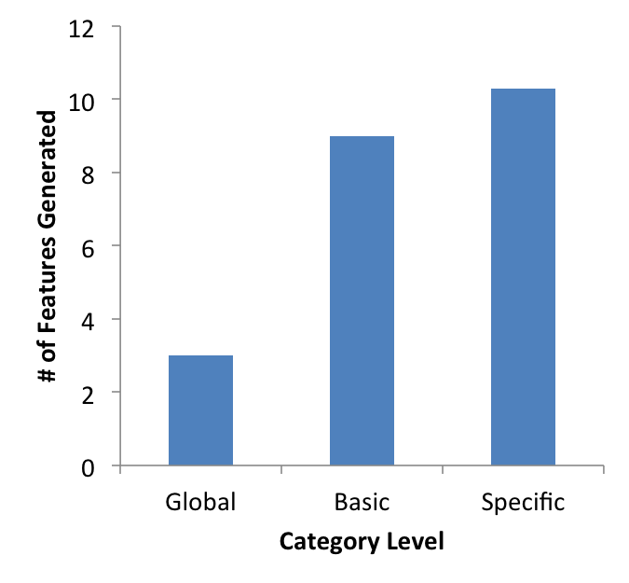
Results
Typical results show that people generate the most features for Specific-Level categories and the fewest features for Global-Level categories. However, there is not a large difference between the Basic and Global levels. Combined with other research showing that people process information most quickly at the Basic Level, this suggests that the Basic Level might be psychologically “privileged” in that it provides a large amount of information most efficiently. In other words, the Basic Level provides the most “bang for your buck.”

